Slide 1
HOUSE PRICE PREDICTION
Date: 25/12/2021

Slide 2
Overview
Problem Statement
Dataset
Exploratory Data Analysis
Data Pre processing
Data Visualization
Conclusion

Slide 3
Problem Statement
The task assigned is to precisely predict the Sales Price for each house having an Id in the Test set given by Training the model using the given Train set to predict the Sales Price variable.

Slide 4
Data Sets
We are given 2 data sets, the Train and Test data sets
The train data set has 1460 instances and 81 features
The test data set has 1459 instances and 80 features excluding the Sales price variable.
We concatenate both the sets and then perform pre-processing to prevent feature mismatch which would lead to an error.
In the combined data, we have 2919 instances and 81 features.

Slide 5
Exploratory Data Analysis
There are 34 columns with at least one null value.
There are 43 object data type features, 12 floating data type features and 26 integer data type features.
The null values can easily change the Sales price to be predicted and skew the data.

Slide 6
Data Pre-Processing
The handling of the null values was done in 3 ways
The features with object data type that had a large number of null values had them changed to ‘none’.
The features with int/float data type had the null values set to 0.
The features with a miniscule number of null values were manually changed to the most occurring value which is the mode(this is done for object data types)

Slide 7
Data visualization
There are 2 plots shown on the next slide, they are the Distribution plot and the probability plot for the Sales price in the train data set.
We convert the Sales prices by using logarithm , now the data gets normally distributed which makes the model better to train with ridge regression.

Slide 8
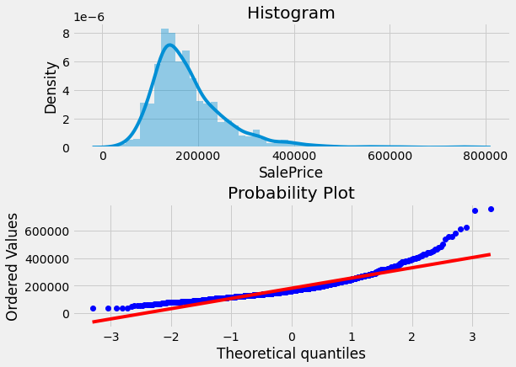
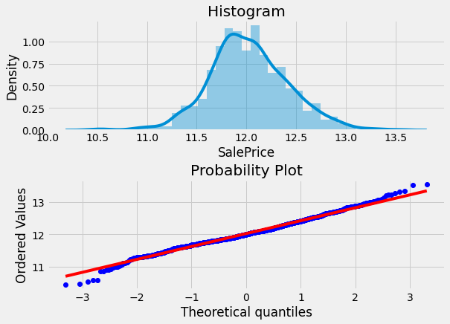
Data Visualization
Distribution plot and probability plot before changing to normal distribution
Distribution plot and probability plot after changing to normal distribution

Slide 9
Process
After the null values are taken care of, we now create dummy variables of the object data type variables and then split the train and test data.
We now use this engineered train data to train the ridge regression model with alpha = 20.
This trained model is then tested with the test data.

Slide 10
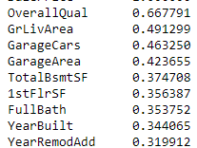
Conclusion
The model has been successfully trained and the accuracy is approximately 86%.
The columns which most affected the Sales price are given below with respect to the square of correlation.
The values shown are in the range 0 to 1.
Thus we can see that the overall quality of the house is the feature that most influenced the Sales price.

Slide 11
Team Members
Mohd. Ateeq Uddin 1604-19-736-086
Syed Mohammed 1604-19-736-081
Siddhi Rohan Chakka 1604-19-736-066
Mohd. Mukarram Ali Ahmed 1604-19-736-090
Khaleelullah Shareef Mohammed 1604-19-736-107

Slide 12
Thank You

